Slide 1
Buikukai Switzerland
Let us introduce ourselves………

Slide 2
Index
Committee
Objectives
Model
Questions

Slide 3
Buikukai Switzerland
Committee
President
Vice- President
Committee Member
Accounts
Secretary

Slide 4
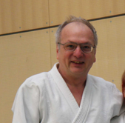
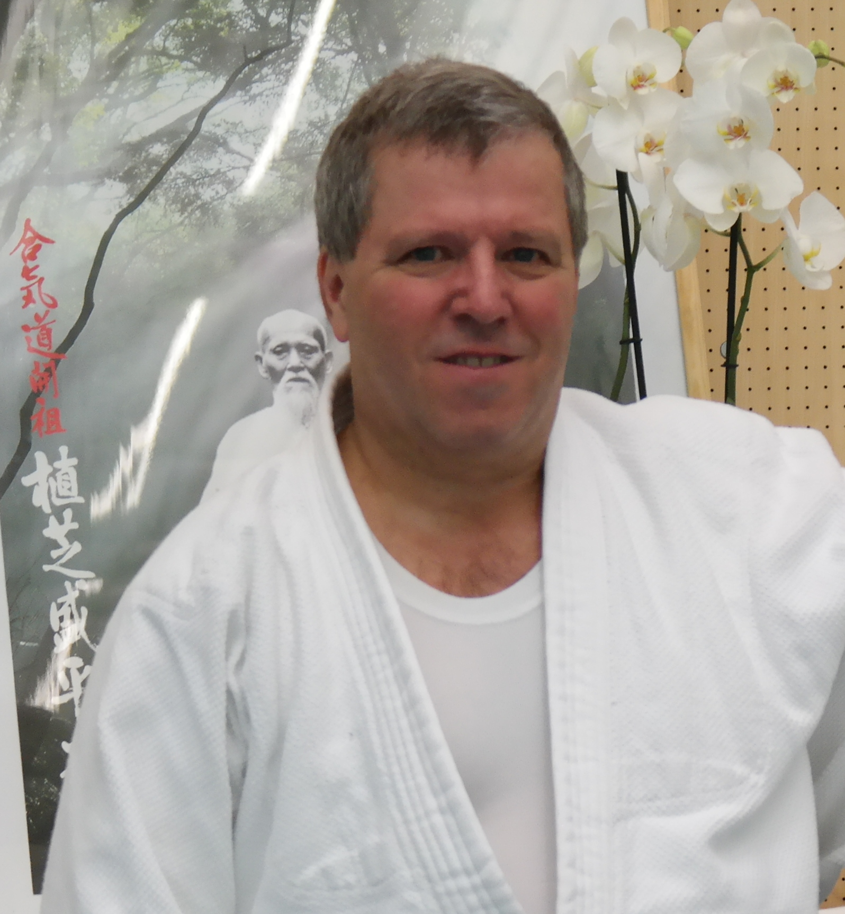
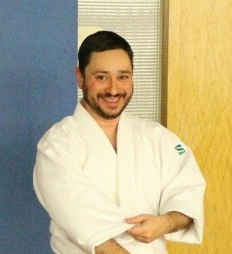
Buikukai Switzerland
Committee
Daniel Zahnd
Aikido Nipon Bern
Sergio Fallica
Aikido Regensdorf
Patrick Vogel
Aikido Nipon Bern
Geraldine Meftah
Aikido Nipon Bern
Santos Beltram
Aikido Palette

Slide 5
Objectives
Close cooperation with Buikukai Osaka
Buikukai Osaka is one of the largest Japanese aikido associations and directly connected to the Hombu Dojo in Tokyo
The ability to conduct Hombu recognised Dan gradings
Close and friendly cooperation with the affiliated Dojos
Provide training and stages
Role Models: Hirokazu Kobayashi, Jiro Kimura und Kazuyasu Kamimura
Promote and further develop Aikido in Switzerland

Slide 6
Model
We actively cultivate cooperation with Buikukai Osaka, the head of which is Jiro Kimura 8th Dan Shihan;
We maintain the values of Aikido
«Jin» Humanity
«Rei» Respect / Etiquette
«Yüki» Courage
«Shin» Sincerity
«Gi» Integrity
«Chügi» Loyalty
«Chi» Knowledge / Wisdom / Intelligence
Our teaching is needs and level-oriented;
We are committed to our sport and promote it both internally as well as publicly;
It is an honour and pleasure to accompany our members along the path of Aikido;
We offer stability, development opportunities and independence.

Slide 7
Questions
?
???
??
????

